Slide 1

Domain: Web Application
Technology: Java
Web Application for Breast Cancer Prediction

Slide 2
Abstract
Introduction
Literature review
Existing Method
Drawbacks
Proposed method
Advantages
Implementation
Hardware and Software Requirements
UML diagrams
Architecture
Results
Conclusion
References

Slide 3
ABSTRACT
Breast cancer is one of the most common and major causes of cancer in women. Currently, it has become a common health problem and recently its incidence has increased. Early detection is the best way to manage breast cancer results. Computer-aided detection or diagnosis (CAD) systems play a major role in early detection of breast cancer and can be used to reduce mortality in women. The main purpose of this paper is to make use of recent advances in the development of CAD systems and related technologies. The main theme of the project is to assess whether a person is suffering from breast cancer. Machine learning is nothing more than training machines to learn and operate on their own without any explicit program or instruction. So here, whether a person is suffering from breast cancer or not can be assessed with the help of trained data.

Slide 4
INTRODUCTION
Breast cancer is a disease in which cells in the breast grow out of control. There are different types of breast cancers. The type of breast cancer depends on which cells in the breast become cancerous.
Breast cancer begins in different parts of the breast. The breast is made up of three main parts: the lobules, the vessels, and the connective tissue. Lobules are glands that produce milk. The vessels are the tubes that carry milk to the nipple. It surrounds the connective tissue (which is composed of fiber and adipose tissue) and holds it all together. Most breast cancers begin in the vessels or lobules.

Slide 5
INTRODUCTION
The Most Common Types of Breast Cancer
Invasive ductal carcinoma. Cancer cells begin in the vessels and grow into other parts of the breast tissue outside the vessels. Invasive cancer cells can spread to other parts of the body or even metastasize.
Invasive lobular carcinoma. Cancer cells begin in the lobules and then spread from the lobules to nearby breast tissues. These invasive cancer cells can spread to other parts of the body.

Slide 6
LITERATURE REVIEW
Sl. No | Publisher & Year | Authors | Title | Outcomes
1 | Elselver & 2021 | Mohammed AmineNajiaSana, ElFilali, KawtarAarika, EL HabibBenlahmar, Rachida AitAbdelouhahid | Machine Learning Algorithms For Breast Cancer Prediction And Diagnosis | Support Vector Machine has demonstrated its efficiency in Breast Cancer prediction and diagnosis and achieves the best performance in terms of accuracy and precision.
2 | IEEE & 2021 | Abeer Saber; Mohamed Sakr; Osama M. Abo-Seida; Arabi Keshk | Automated Breast Cancer Detection and Classification Techniques – A survey | The strategies for detecting and classifying breast tumors that have been created at various stages are illustrated. The measures used to evaluate performance are examined, as well as the future outlook and trends.

Slide 7
LITERATURE REVIEW
Sl. No | Publisher & Year | Authors | Title | Outcomes
3 | Springer & 2020 | Md. Milon Islam, ·Md. Rezwanul Haque, Hasib Iqbal, Md. Munirul Hasan, Mahmudul Hasan, Muhammad Nomani Kabir | Breast Cancer Prediction: A Comparative Study Using Machine Learning Techniques | In this, the machine learning technique can be acted as a clinical assistant for the diagnosis of breast cancer and will be very helpful for new doctors or physicians in case of misdiagnosis.
4 | Sciencedirect & 2020 | Anji ReddyVaka, BadalSoni, Sudheer ReddyK | Breast cancer detection by leveraging Machine Learning | The authors present the new method DNNS for detecting Breast Cancer. Unlike other methods, the proposed method is based on Support value on a deep neural network. To meet the better performance, efficiency, and quality of images, a normalization process has been employed.

Slide 8
EXISTING METHOD
In an existing system, it is important for physicians to diagnose various conditions related to Brest cancer Detection at an early stage because early detection can prevent or reverse kidney damage. Early detection can provide better treatment and proper care for patients. Many regional hospitals / clinics have a shortage of nephrologists or general practitioners to diagnose symptoms.

Slide 9
EXISTING METHOD
Over time, companies will be able to implement the proposed machine learning framework in regional clinics with less medical professional retention, providing early diagnosis to patients in regional areas. This process can take a long time and is even more costly.

Slide 10

DISADVANTAGES
Time efficiency is high
Have manual work is high
It is costly

Slide 11
PROPOSED METHOD
In proposed system, we are predicting the breast cancer using Existing records. In this we are initially collect the existing records then store into our system. Then we predict the results for Brest cancer based on their parameter values. This procedure can be have taken less time and cost sufficient.

Slide 12
ADVANTAGES
Less time efficiency
Reducing manual work
Less cost

Slide 13
Implementation
Modules
Admin: admin login with valid credentials. Upload Existing recorders. View users. Add new record.
Users: Users initially register with their details then login with registered details, predict breast cancer and view their existing predicted results.

Slide 14
SYSTEM SPECIFICATION
H/W System Configuration
Processor - I3/Intel Processor
RAM - 4GB (min)
Hard Disk - 500GB
Key Board - Standard Windows Keyboard
Mouse - Two or Three Button Mouse
Monitor - SVGA

Slide 15
SYSTEM SPECIFICATION
S/W System Configuration
Operating System : Windows 7/8/10
Application Server : Tomcat 9.0
Front End : HTML, JSP
Scripts : JavaScript.
Server side Script : Java Server Pages.
Database : My SQL 6.0
Database Connectivity : JDBC

Slide 16
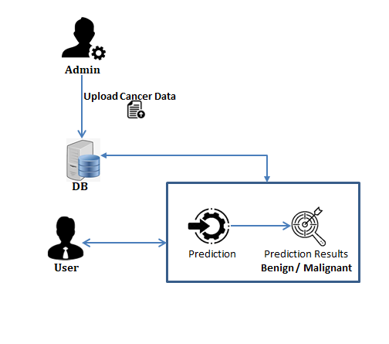
Architecture

Slide 17
UML diagrams
CLASS DIAGRAM:
In software engineering, a class diagram in the Unified Modeling Language (UML) is a type of static structure diagram that describes the structure of a system by showing the system's classes, their attributes, operations (or methods), and the relationships among the classes. It explains which class contains information.

Slide 19
USE CASE DIAGRAM:
A use case diagram in the Unified Modeling Language (UML) is a type of behavioral diagram defined by and created from a Use-case analysis. Its purpose is to present a graphical overview of the functionality provided by a system in terms of actors, their goals (represented as use cases), and any dependencies between those use cases.

Slide 21
SEQUENCE DIAGRAM:
A sequence diagram in Unified Modeling Language (UML) is a kind of interaction diagram that shows how processes operate with one another and in what order. It is a construct of a Message Sequence Chart. Sequence diagrams are sometimes called event diagrams, event scenarios, and timing diagrams.

Slide 23
Collaboration Diagram:
In collaboration diagram the method call sequence is indicated by some numbering technique as shown below. The number indicates how the methods are called one after another. We have taken the same order management system to describe the collaboration diagram. The method calls are similar to that of a sequence diagram. But the difference is that the sequence diagram does not describe the object organization whereas the collaboration diagram shows the object organization.

Slide 25
ACTIVITY DIAGRAM:
Activity diagrams are graphical representations of workflows of stepwise activities and actions with support for choice, iteration and concurrency. In the Unified Modelling Language, activity diagrams can be used to describe the business and operational step-by-step workflows of components in a system. An activity diagram shows the overall flow of control.

Slide 27
Component diagram,
A component diagram, also known as a UML component diagram, describes the organization and wiring of the physical components in a system. Component diagrams are often drawn to help model implementation details and double-check that every aspect of the system's required functions is covered by planned development.

Slide 29
DEPLOYMENT DIAGRAM
Deployment diagram represents the deployment view of a system. It is related to the component diagram. Because the components are deployed using the deployment diagrams. A deployment diagram consists of nodes. Nodes are nothing but physical hardware’s used to deploy the application.

Slide 31

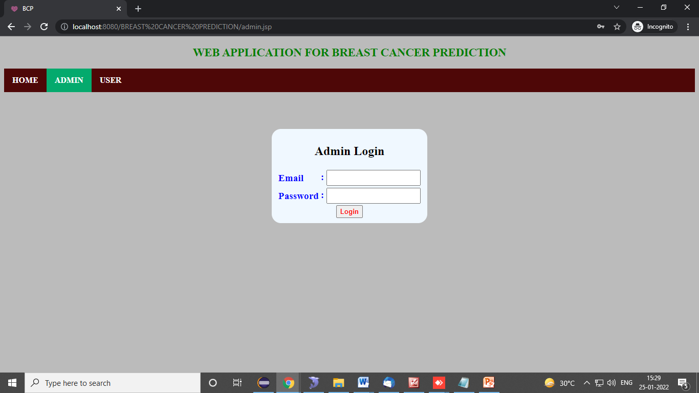
Results
Home : this is the initial page of our project
Admin login : this admin login page

Slide 32
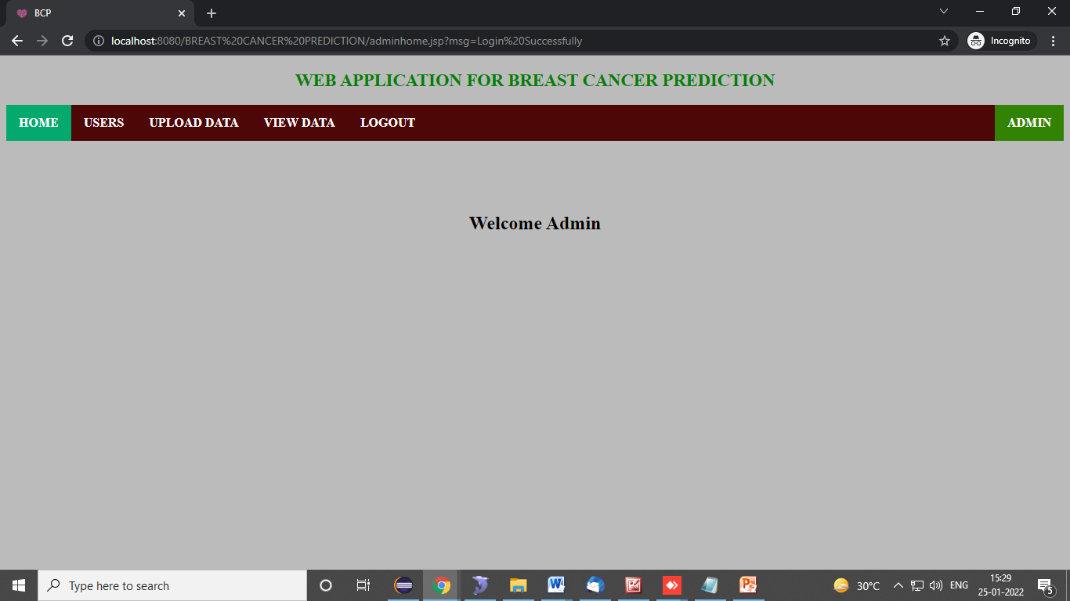
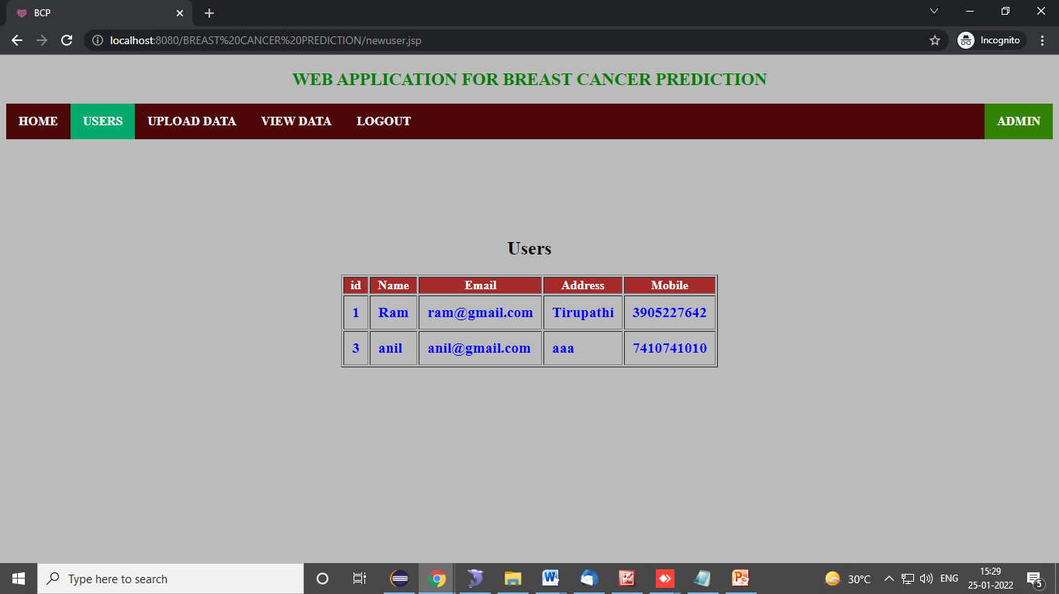
Results
Admin home : this is admin home page. In this we can view all available admin features.
Users: admin view user details

Slide 33
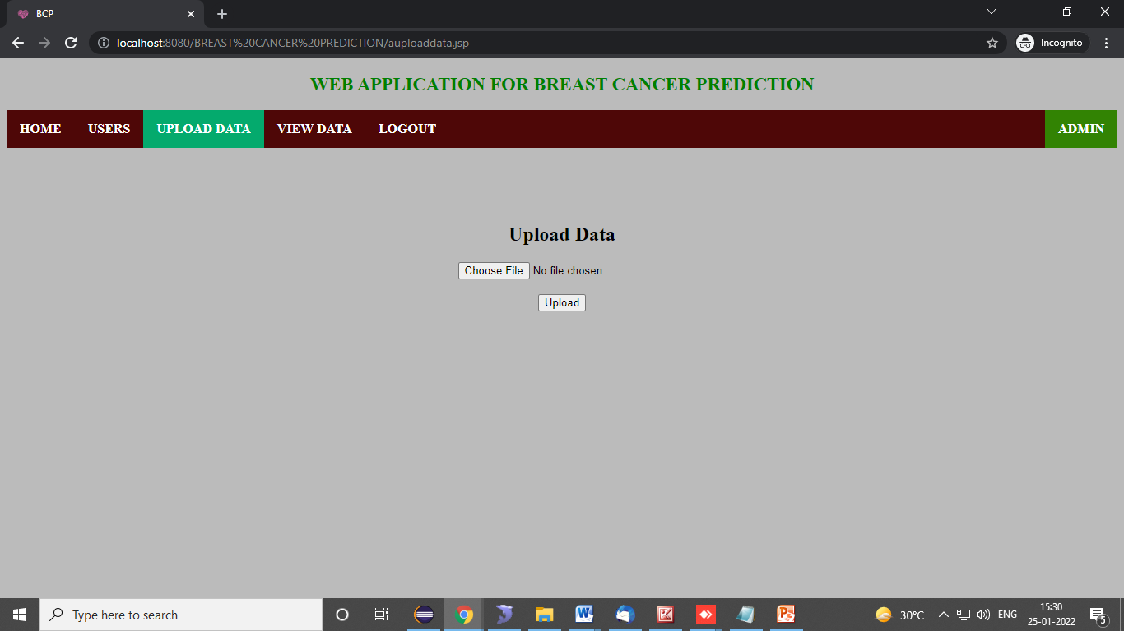

Results
Upload Data: admin here upload breast cancer dataset
Upload Data: If we have already data uploaded this will ask to confirm to delete old data and upload new data

Slide 34
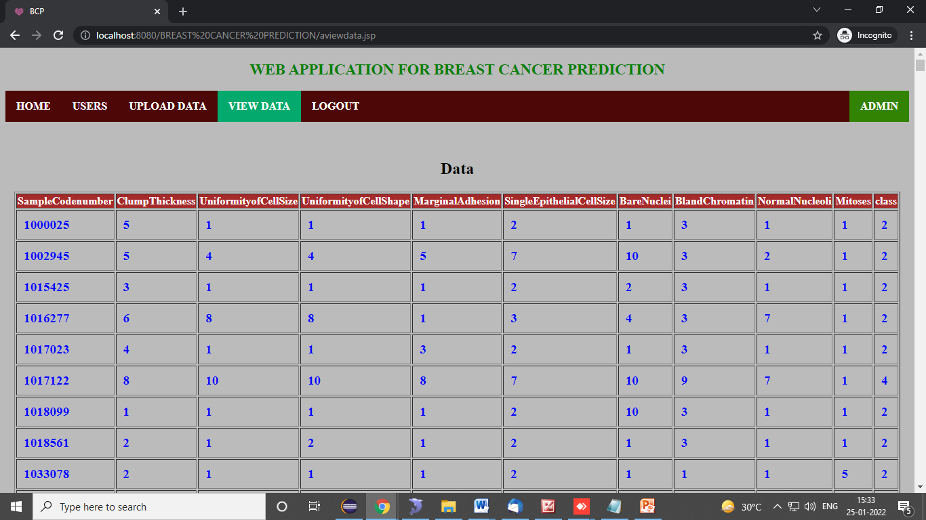
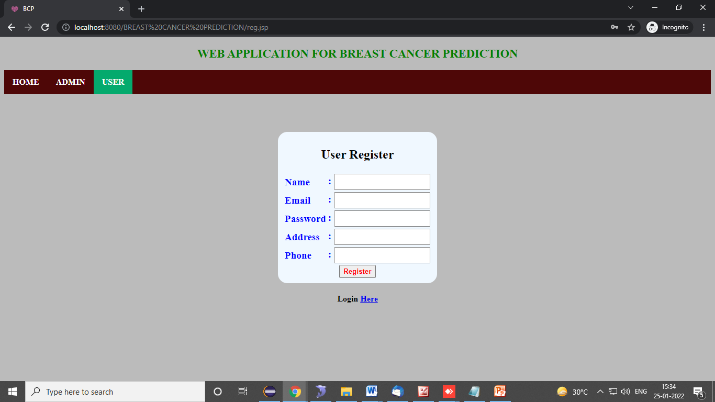
Results
View data: here admin view uploaded data details
User register: user register with their details

Slide 35
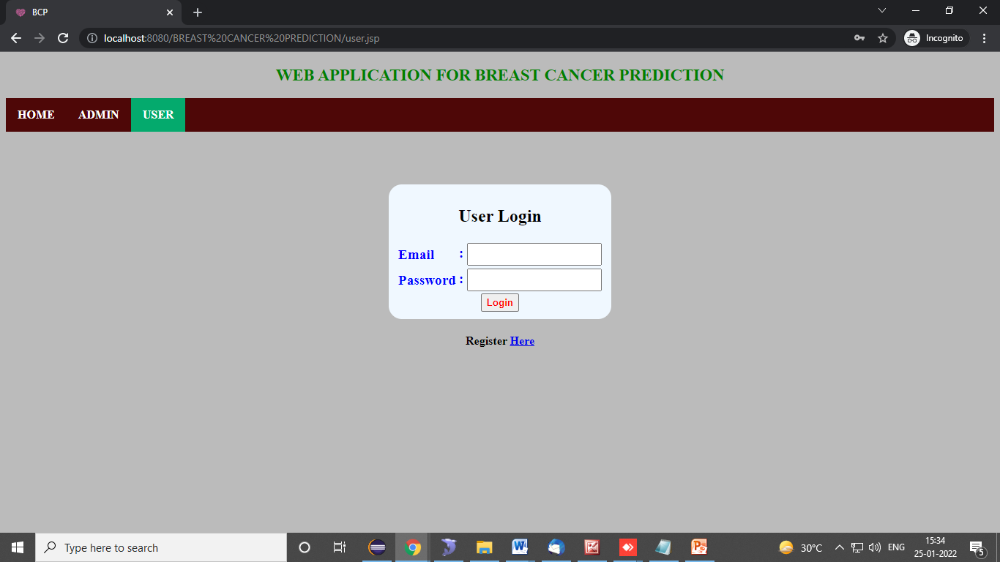
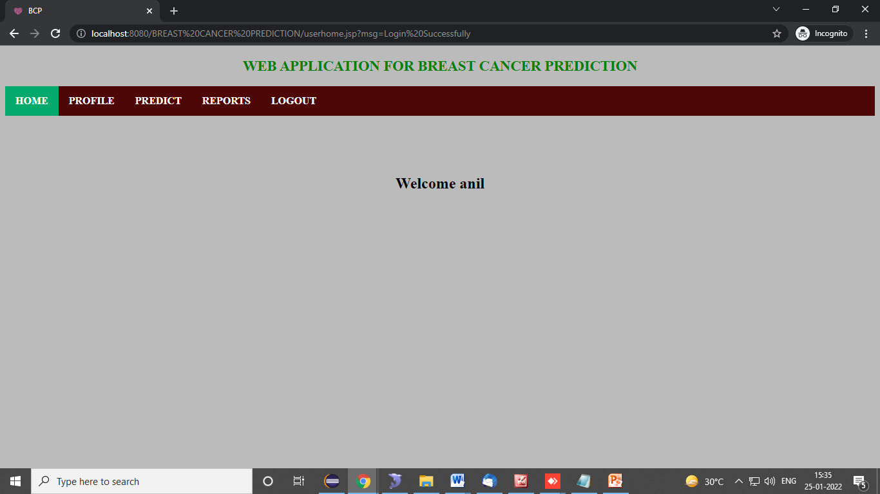
Results
User login : user login with email and password
User home : this is user home page. In this we can view all available user features.

Slide 36
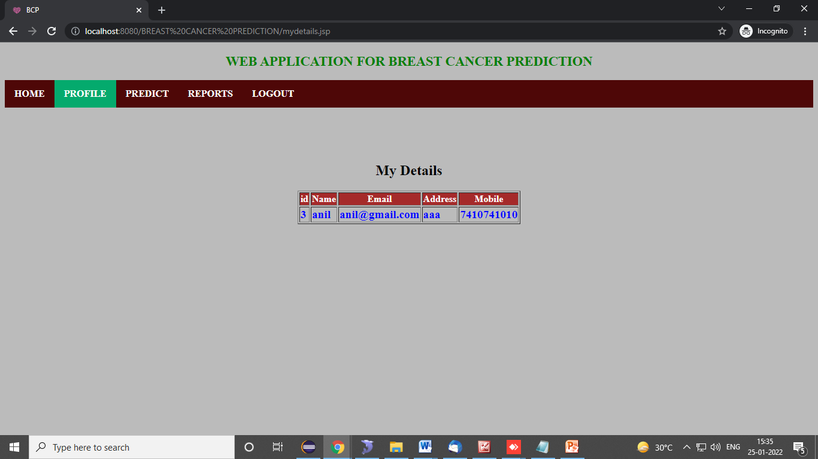
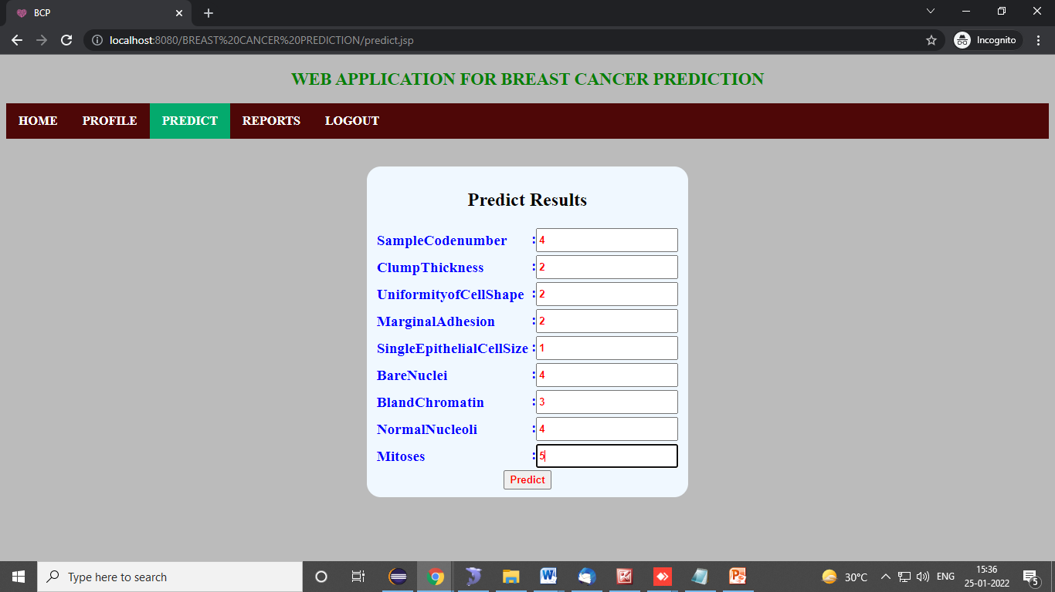
Results
profile : this is user profile
predict: user predict the breast caner

Slide 37
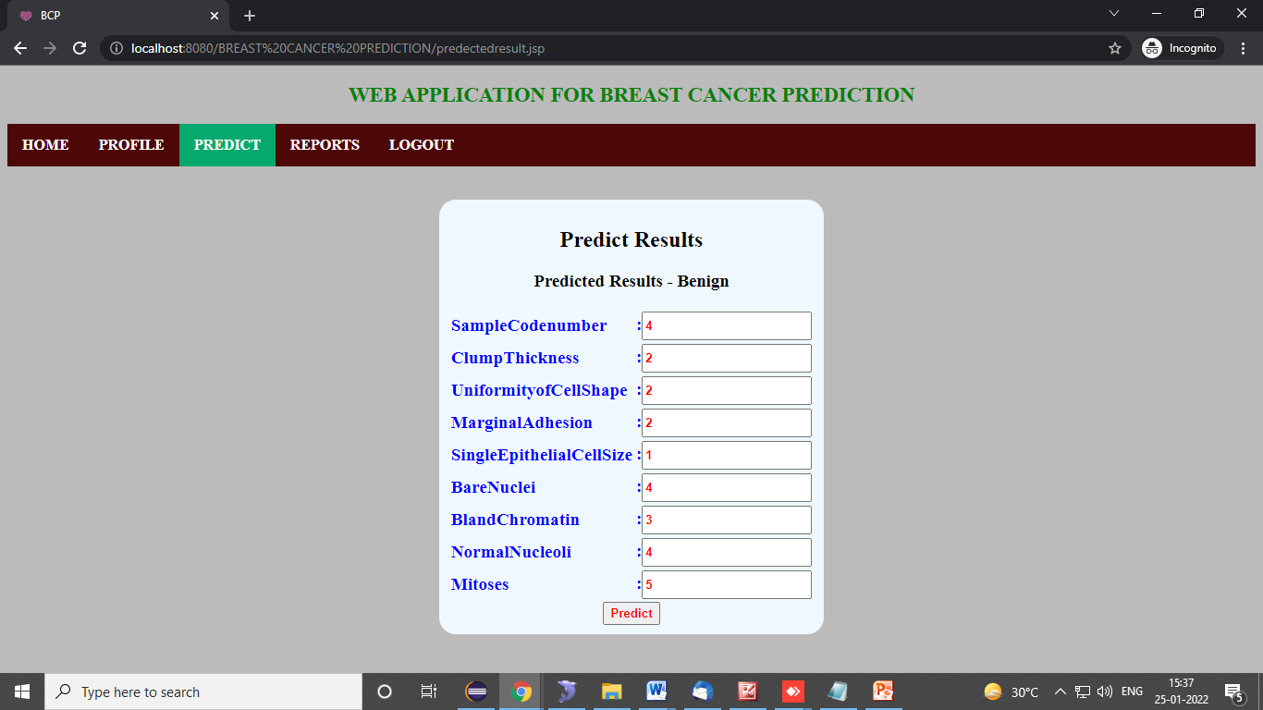

Results
Prediction results1
Prediction results2

Slide 38
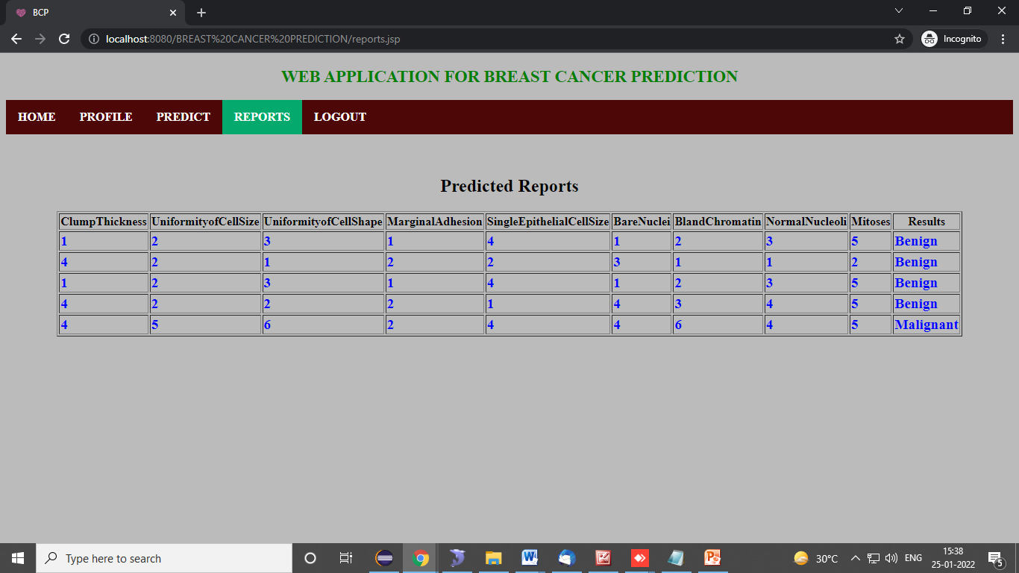
Results
Report: user predicted results

Slide 39
CONCLUSION
In our application we are predicting the breast cancer. By using the existing records i.e., database results. In this user can predict results, and check their existing predicted results. And admin can add new records into database. This can be helpful to next predicting results.

Slide 40
REFERENCES
Machine Learning Algorithms For Breast Cancer Prediction And Diagnosis from Elselver & 2021
Automated Breast Cancer Detection and Classification Techniques – A survey from IEEE & 2021
Breast Cancer Prediction: A Comparative Study Using Machine Learning Techniques from Springer & 2020
Breast cancer detection by leveraging Machine Learning from Science direct & 2020

